Slide 1
Mathematics & Statistics
ES1032
DR. R. S. DESHPANDE

Slide 2
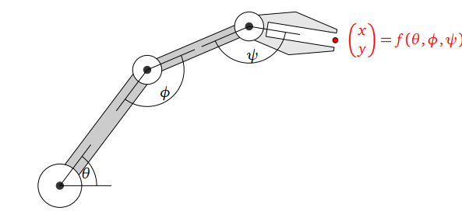
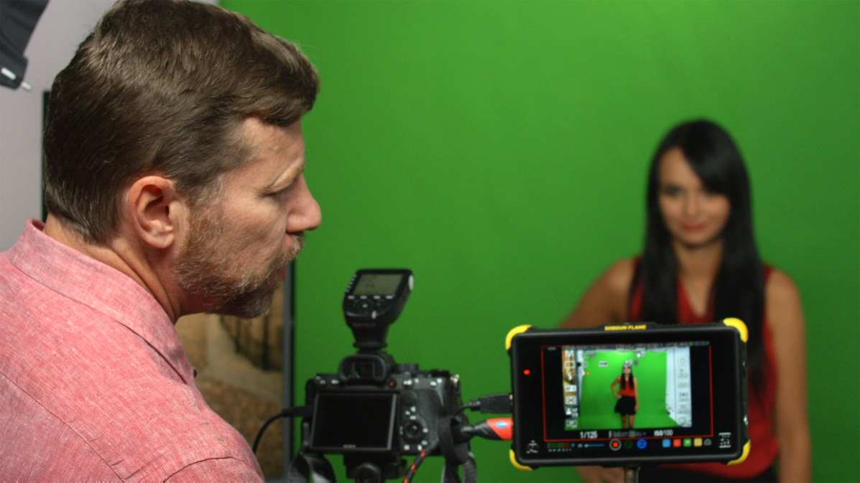
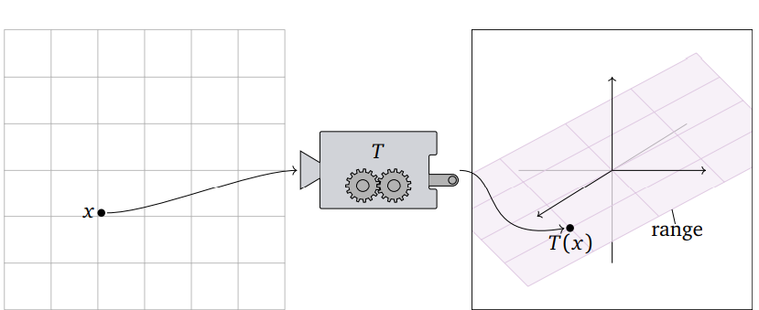

Slide 4
Linear Transformation

Slide 6
Domain and Codomain of a Linear Transformation
Domain
T
Codomain
V
W

Slide 16
Matrix of a Linear Transformation

Slide 21
Invertible Linear Transformation

Slide 23
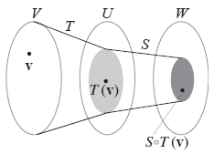
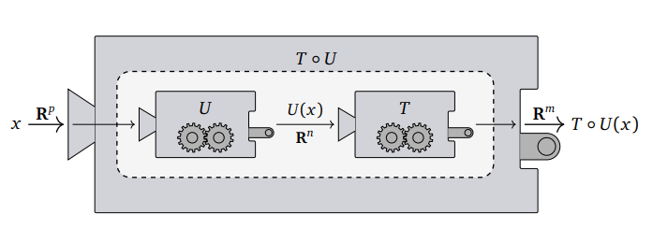
Composite Linear Transformation

